Slide 1
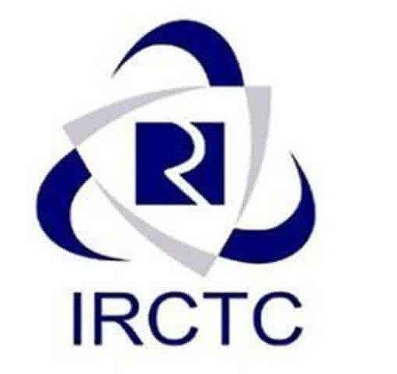
DBMS Project IRCTC Clone
Ujjwal Godara 2020345
Arvind 2020286
Rahul Raj 2020322
Shivam Aggarwal 2020123

Slide 2
Scope of Project
IRCTC stands for Indian Railways Catering and Tourism Corporation. It is an Indian public sector that provides ticketing, catering and tourism services to Indian railways. Major portion of users use IRCTC app for ticketing only.
The system provides a functionality to passengers to add themselves to the view the train listings. The user can also update their personal details in the system. The system performs functions like providing the best options of the available trains from a specified source and the destination to the passengers. The train details has comprehensive information like train number, train name, train type, available class types along with respective fares, the frequency of the train during the week, seat availability, route and stoppage details and total distance and total time taken for the journey.
Passengers can book their tickets based on their preference and availability. The system also provides a functionality to the passenger to cancel their tickets.
The super admin of the user can add, update and delete new trains from the system, manage stations and route details and also manage passengers.

Slide 3
Entities
Passenger: This table includes information about the passenger who would be travelling such as name, contact details, age and user id.
Ticket: This table includes passenger details corresponding to the specific source and destination, date of journey, PNR, Train no and fare.
Station: This table contains the station name, Location and station Code.
Train: This table contains train name, train number, total seats, Departure date and time.
User: This table contains User ID, Age, Name and Contact no.

Slide 4
Stakeholders:
Passengers, Govt. Officials of Railways (Super Admin)
Entities
User, Passenger, Train, Station, Ticket
Ternary Relationship
No ternary relationship
Weak Entity
Passenger because it does not have any key attributes of its own. Identifies by relation to another entity type

Slide 5
Relationship Between entities:
SR. No. | Relationship Type | Entities Involved | Entity Relationship
1 | Registers | User and Passengers | One to many
2 | Boards | Passengers and Trains | One to one
3 | Buys | Passengers and Ticket | One to one
4 | Source, End | Train and Station | One to one
5 | Registers | Passengers And User | One to one
6 | Boards | Trains and Passengers | One to total seats
7 | Buys | Ticket and Passengers | One to one
8 | Source, End | Station and Train | One to many

Slide 6
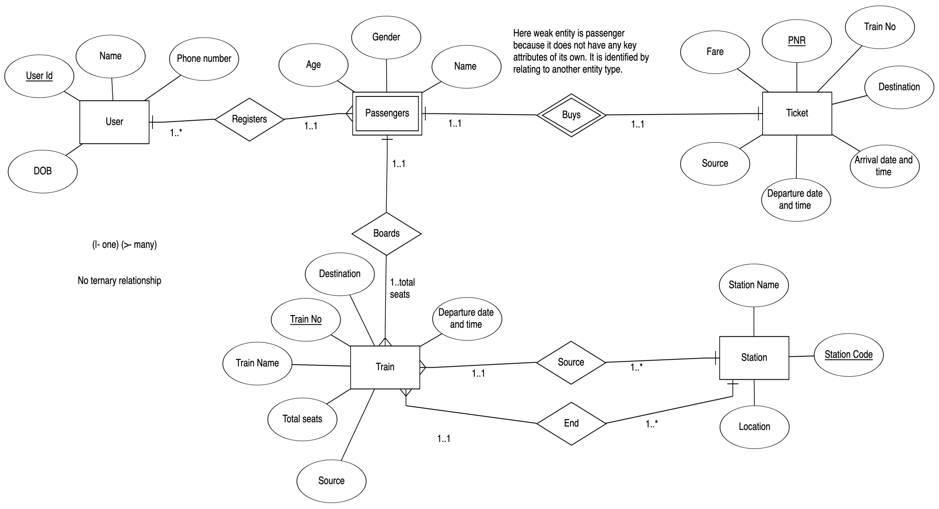
ER Diagram

Slide 7
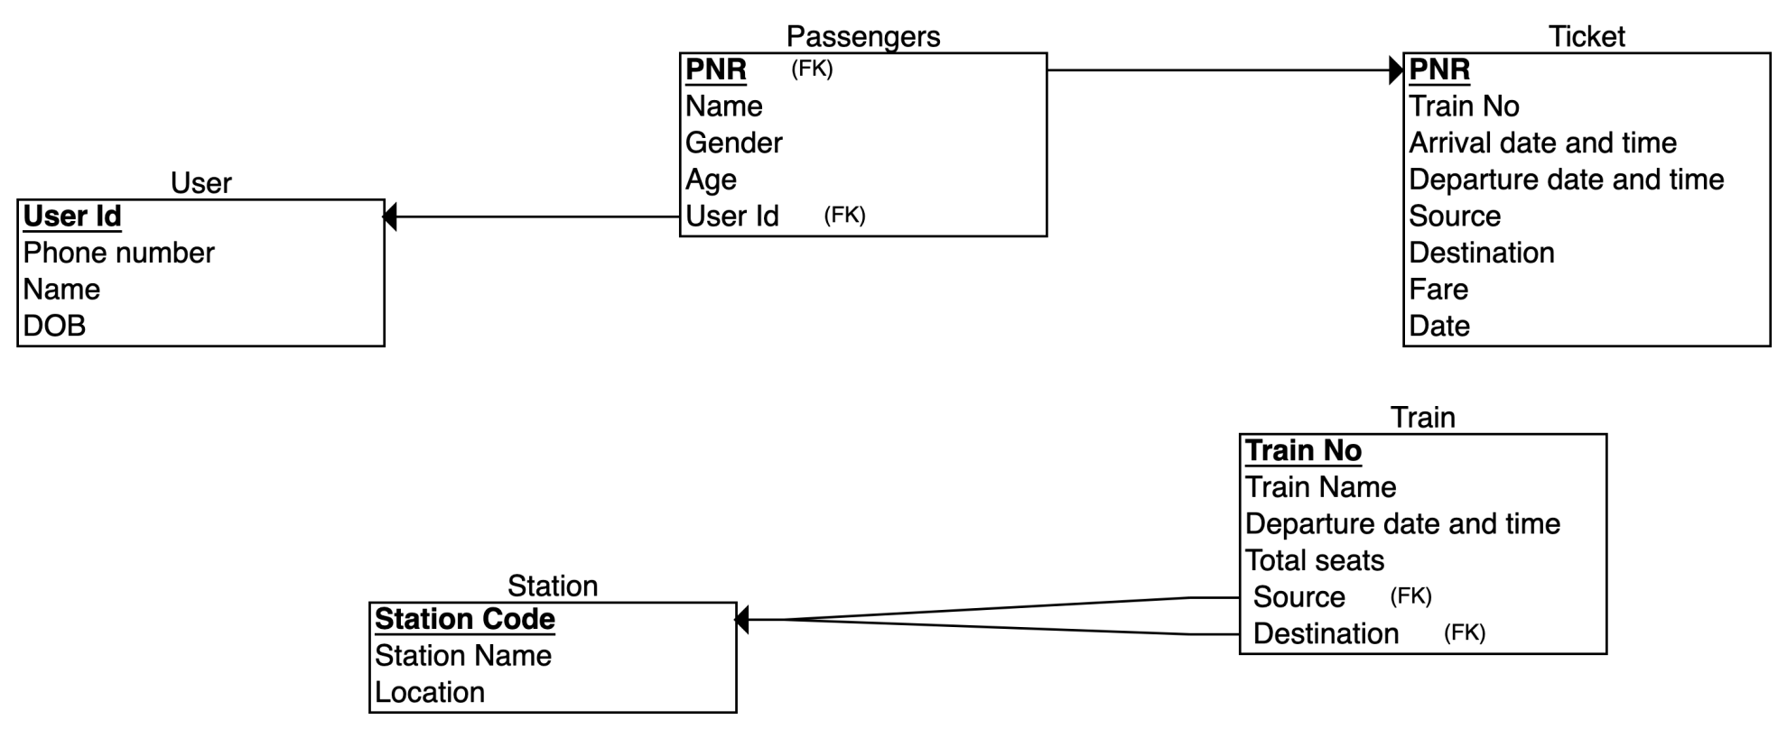
Relational Schema

Slide 8
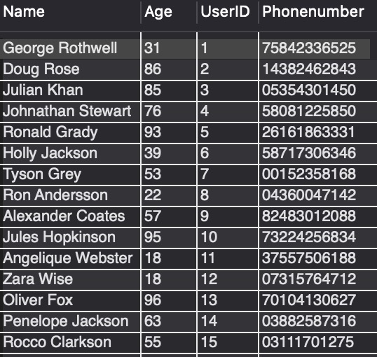
Tables & Data Population
User
PK: User ID

Slide 9
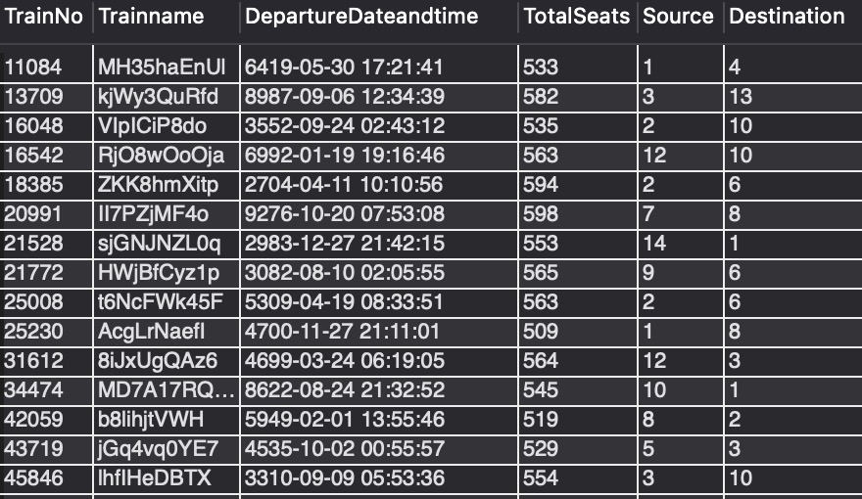
Train PK: Train No

Slide 10
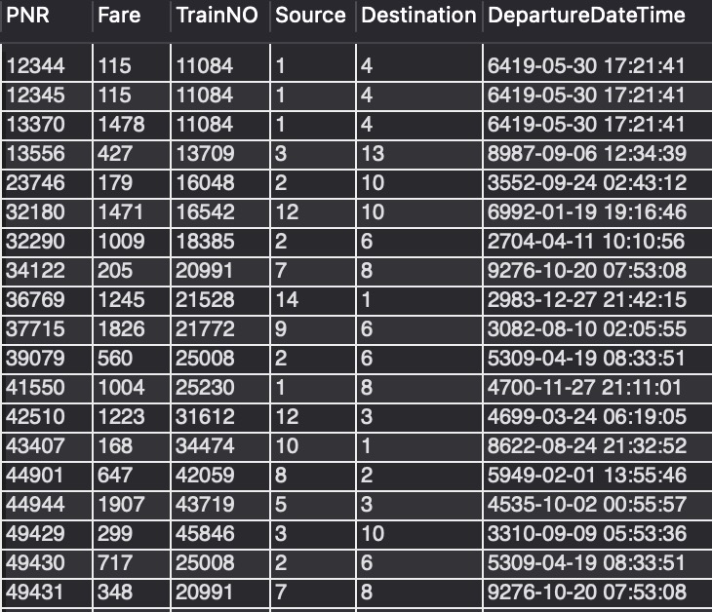
Ticket PK: PNR

Slide 11
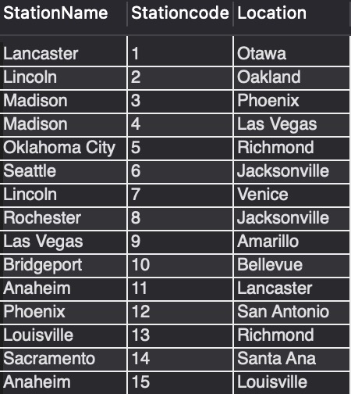
Station
PK: Station
Code

Slide 12
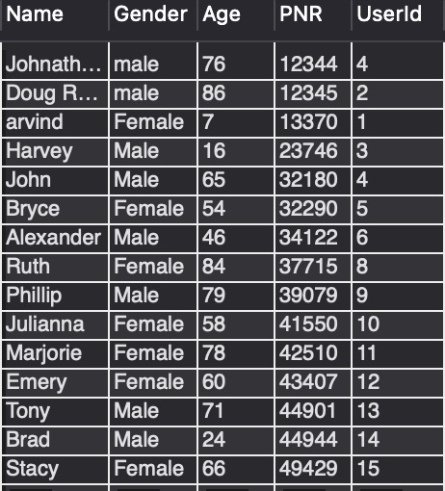
Passenger
PK: PNR

Slide 13
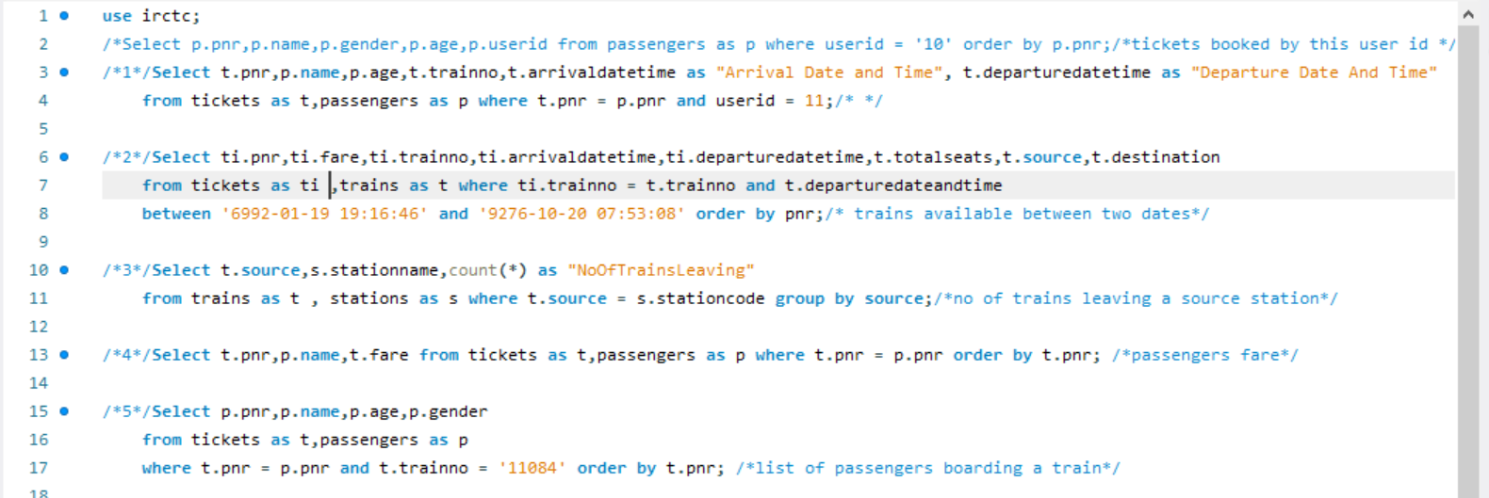
SQL Queries (for mid-sem)

Slide 14
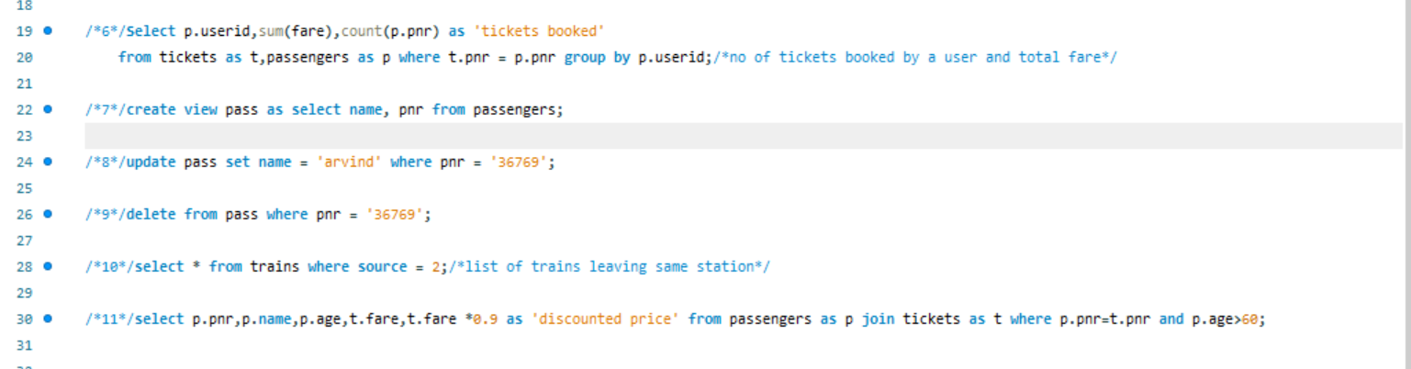

Slide 15
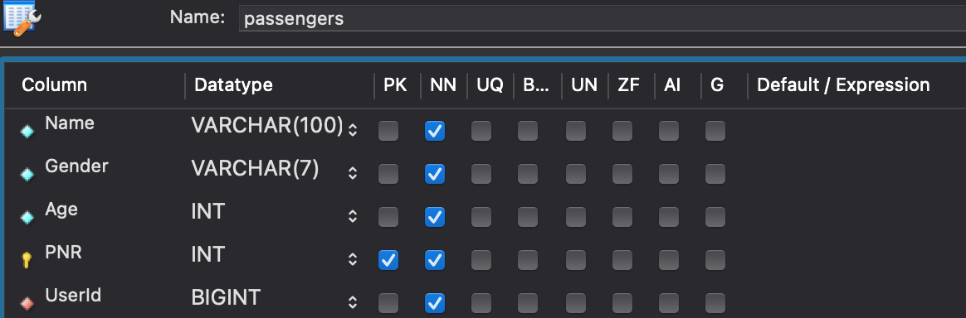
Constraints
Constraints are used to limit the type of data that can go into a table. This ensures the accuracy and reliability of the data in the table.
Passengers

Slide 16
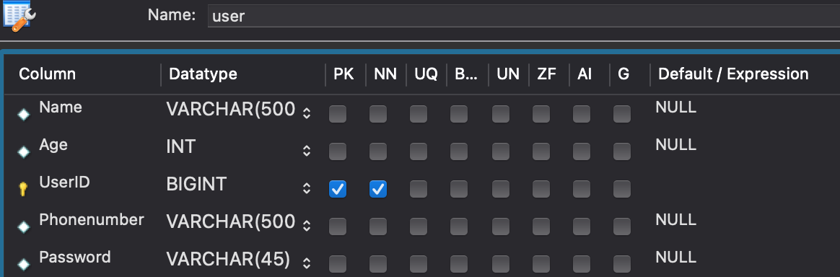
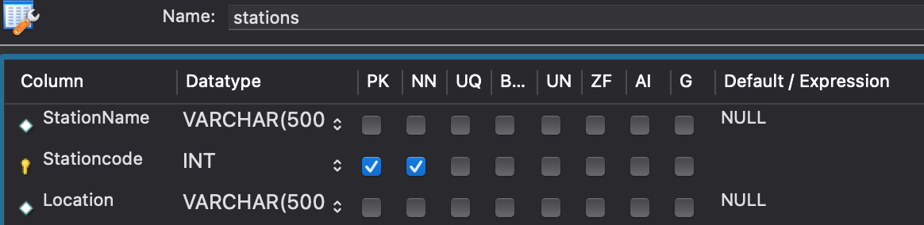
-User
-Stations

Slide 17
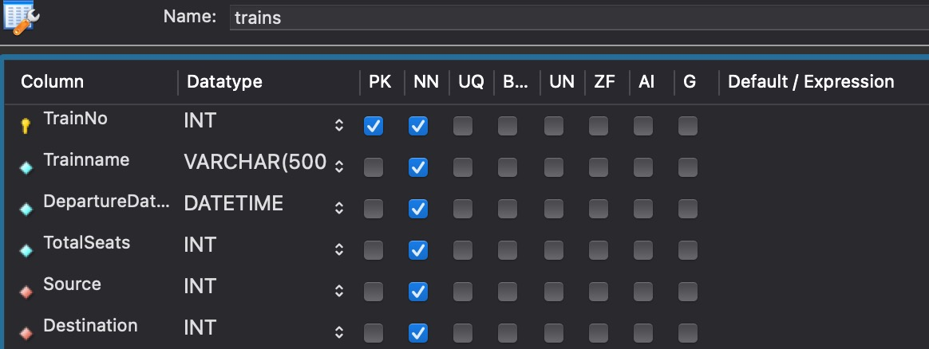
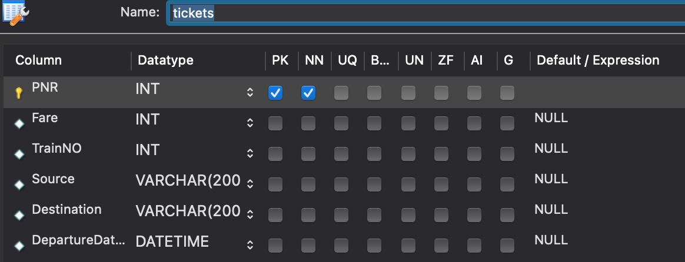
-Trains
-Tickets

Slide 18
Views and Grants
Views- View is a virtual table based on the result-set of an SQL statement.
Grants - SQL Grant is used to provide permissions like Select, All, Execute to user on the database objects like Tables, Views, Databases and other objects in a SQL Server.
There are 2 views – Passenger and Admin
Passengers can book their tickets based on their preference and availability. The system also provides a functionality to the passenger to cancel their tickets.
The super admin of the user can add, update and delete new trains from the system, manage stations and route details and also manage passengers.

Slide 19
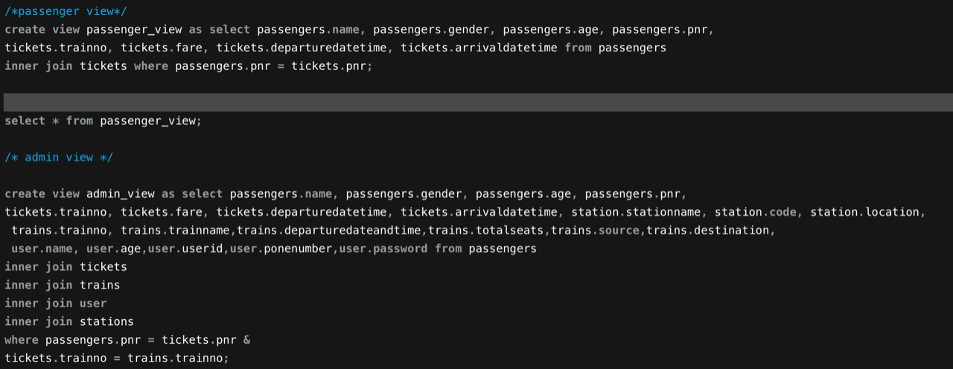
Views

Slide 20
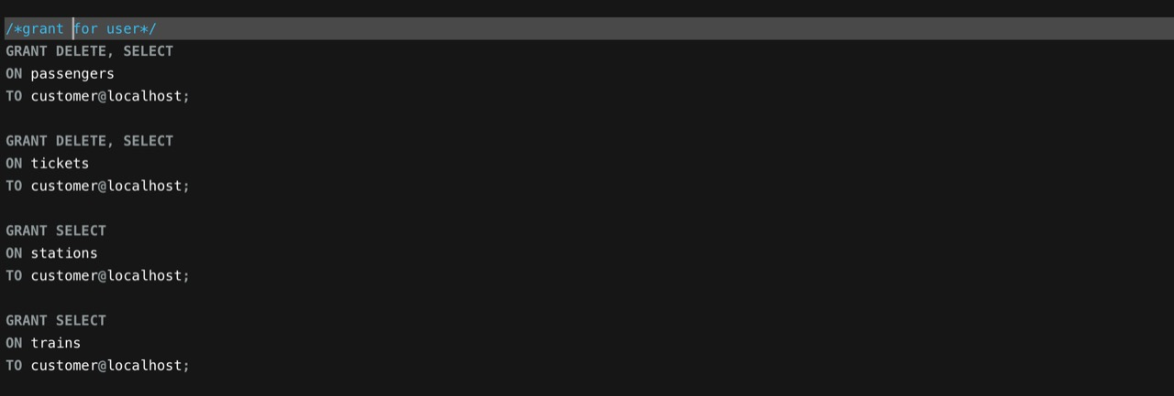
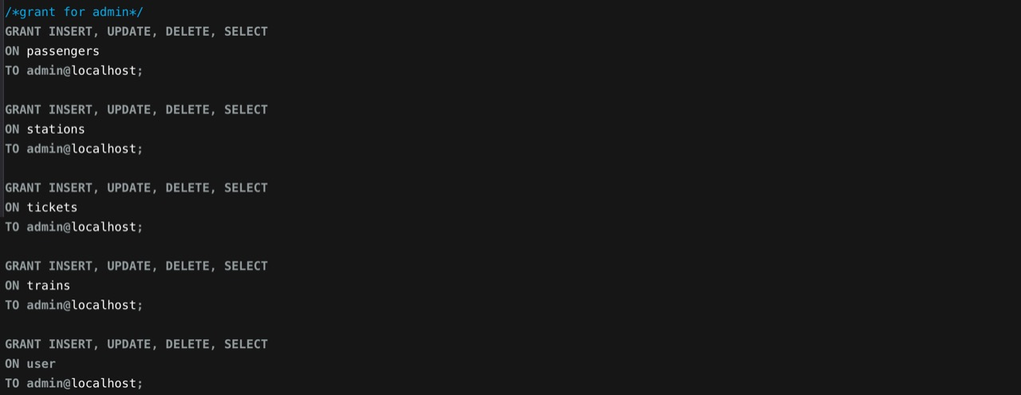
Grants

Slide 21
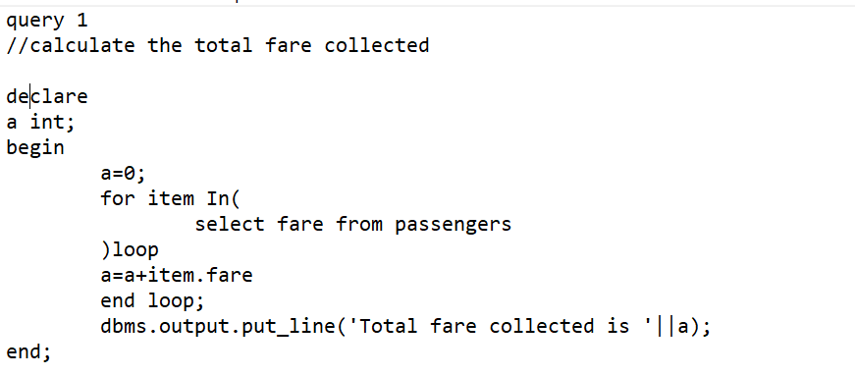
Embedded SQL Queries
Embedded SQL is a method of combining the computing power of a programming language and the database manipulation capabilities of SQL

Slide 22
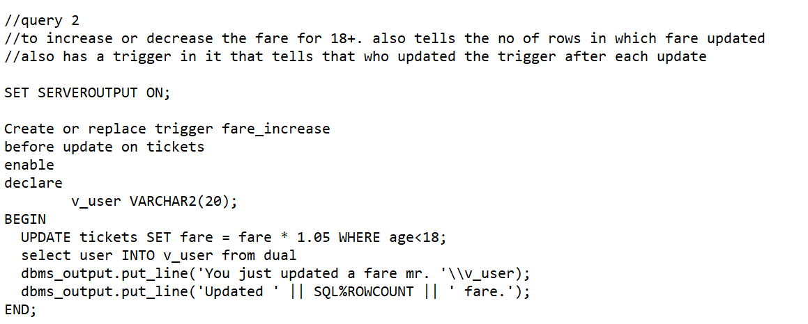
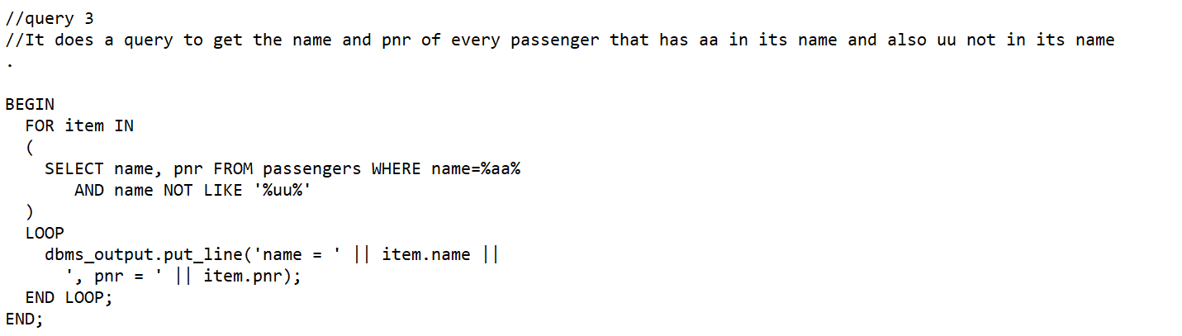

Slide 23
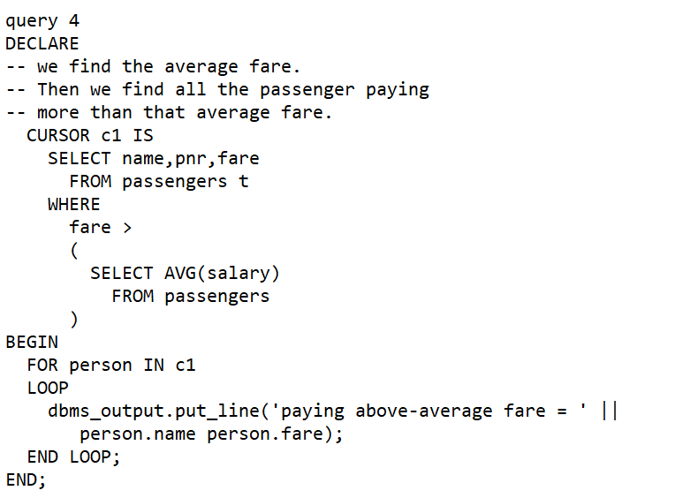
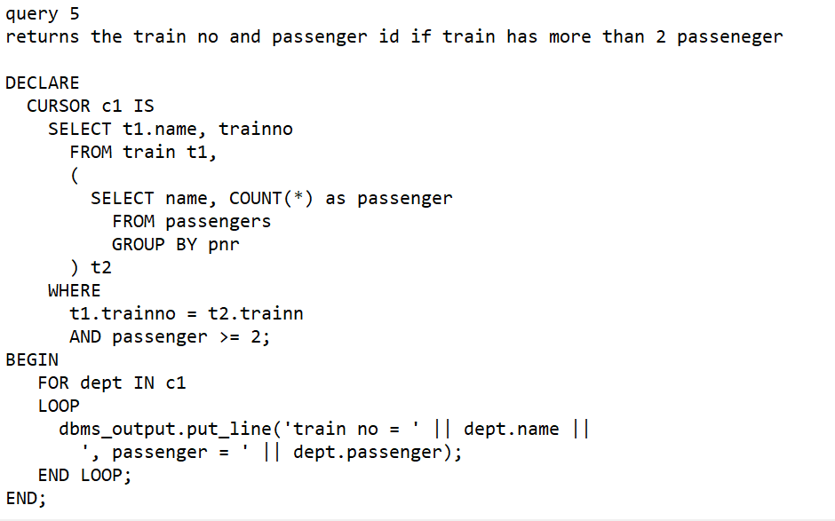

Slide 24
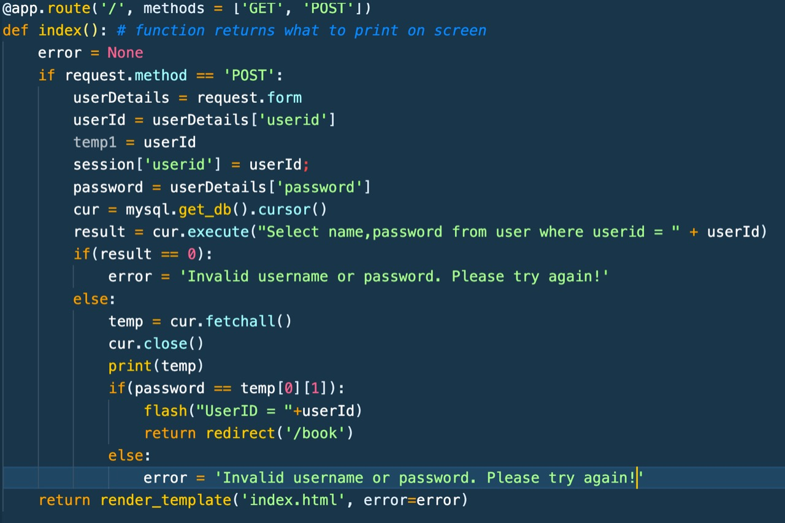

Slide 25
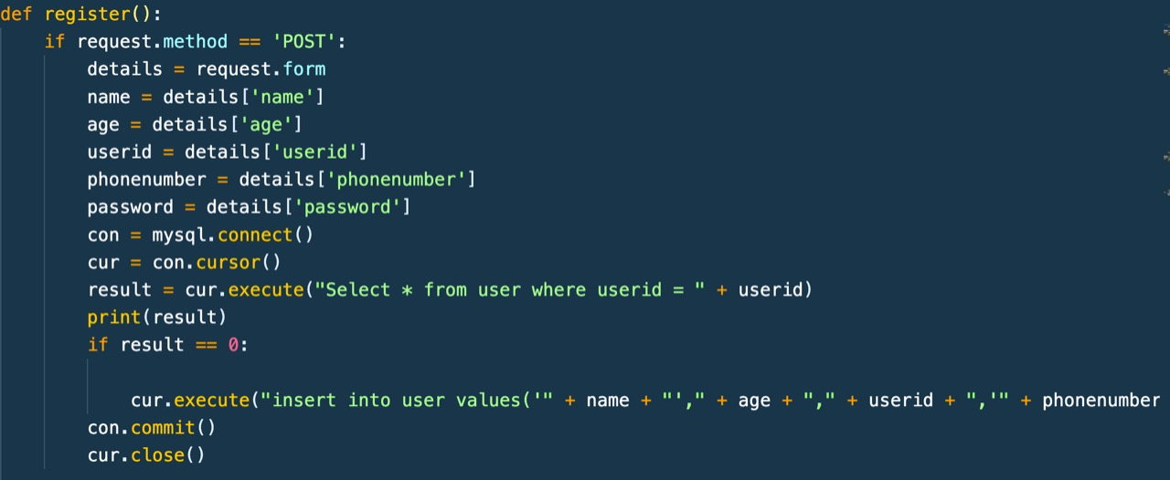

Slide 26
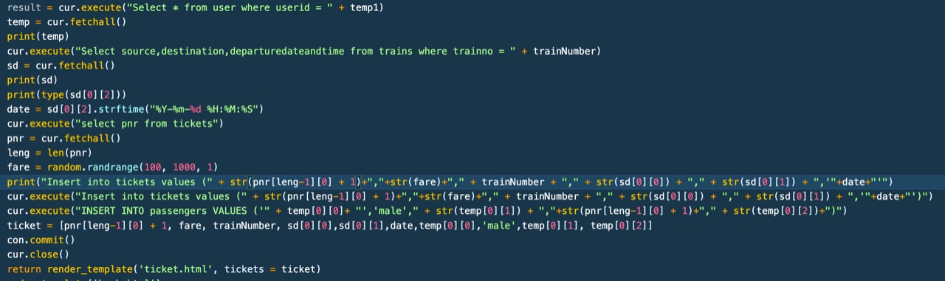
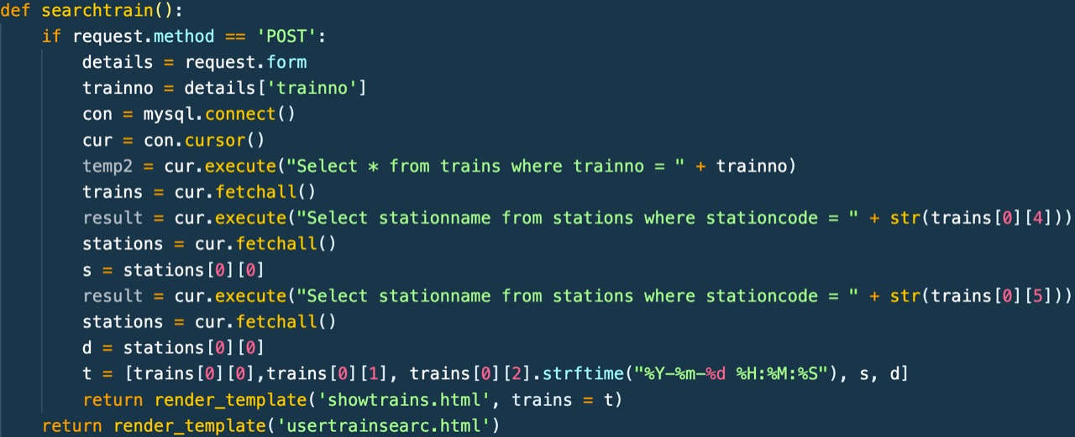

Slide 27
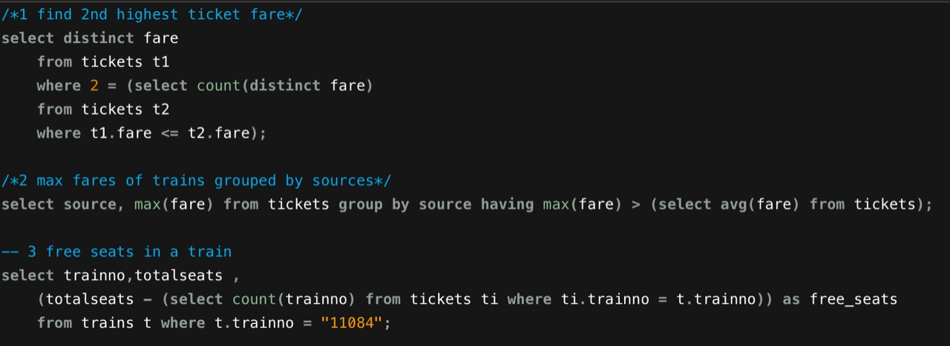
SQL Queries (for end-sem)

Slide 28
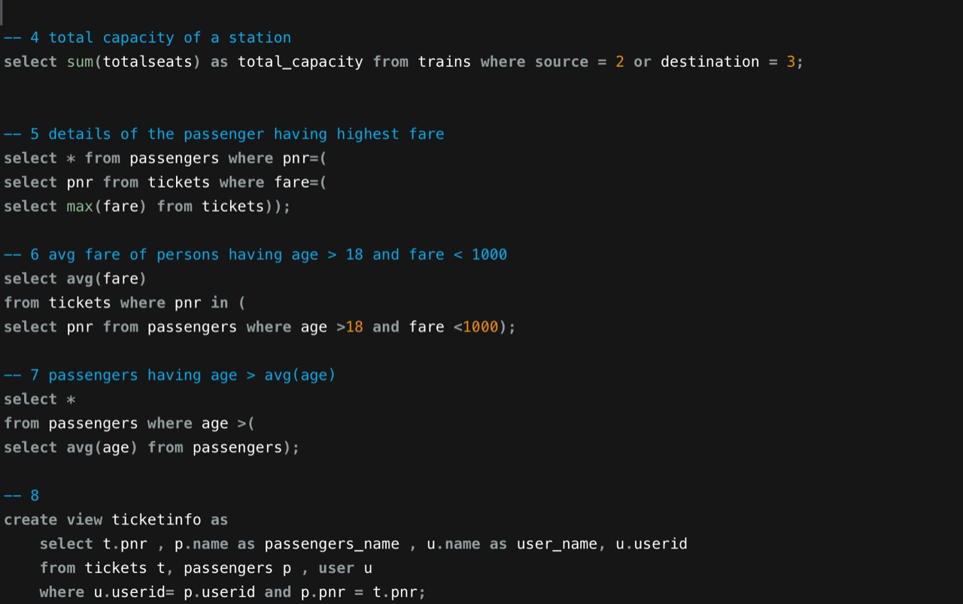
Query 4-8

Slide 29
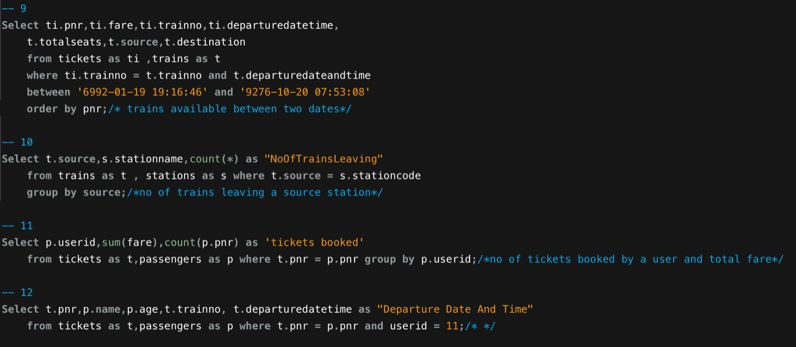
Query 8-12

Slide 30
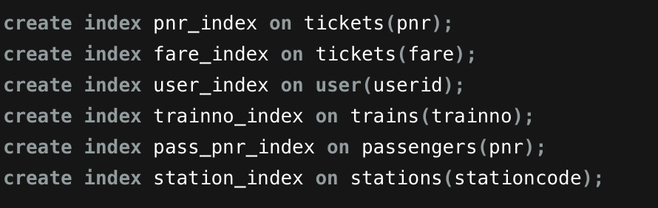
Query optimization
SQL Query optimization is defined as the iterative process of enhancing the performance of a query in terms of execution time, the number of disk accesses, and many more cost measuring criteria
- Adding indexes : Table indexes in databases help retrieve information faster and more efficiently

Slide 31
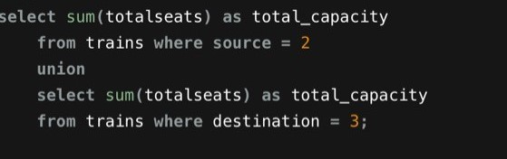
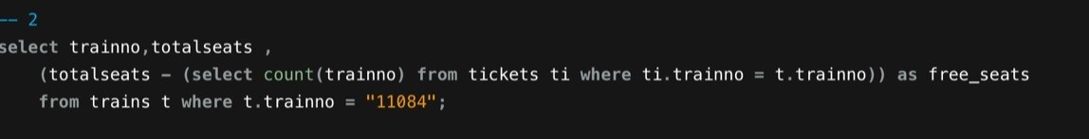
- Avoid using multiple OR: It evaluates each component of the OR which, in turn, may lead to poor performance. Use Union instead.
- Use SELECT fields instead of SELECT *: Selecting limited data increases the performance

Slide 32
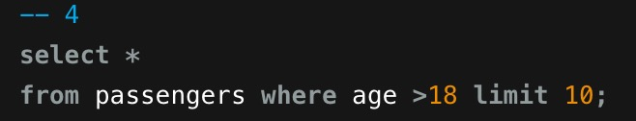
LIMIT command: The limit command is used to control the number of rows to be displayed from the result set.
- Use wildcard wisely: Having the wildcard (%) at the end of the string when searching on uncertain characters is not as challenging as having the wildcard at the beginning of the search string.

Slide 33
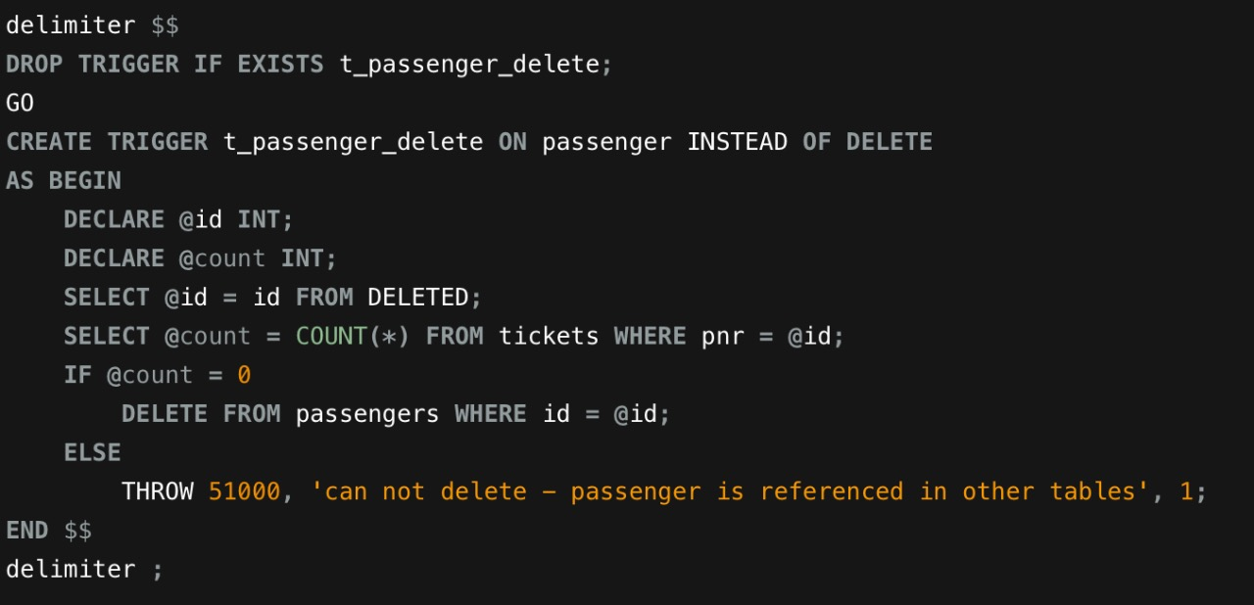
Triggers
A SQL trigger is a database object which fires when an event occurs in a database

Slide 34
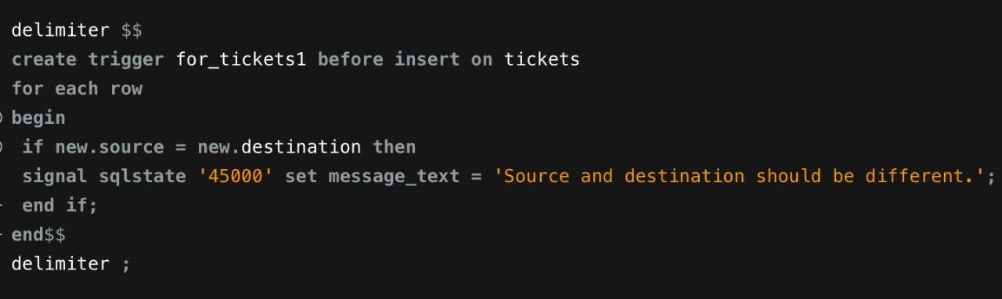
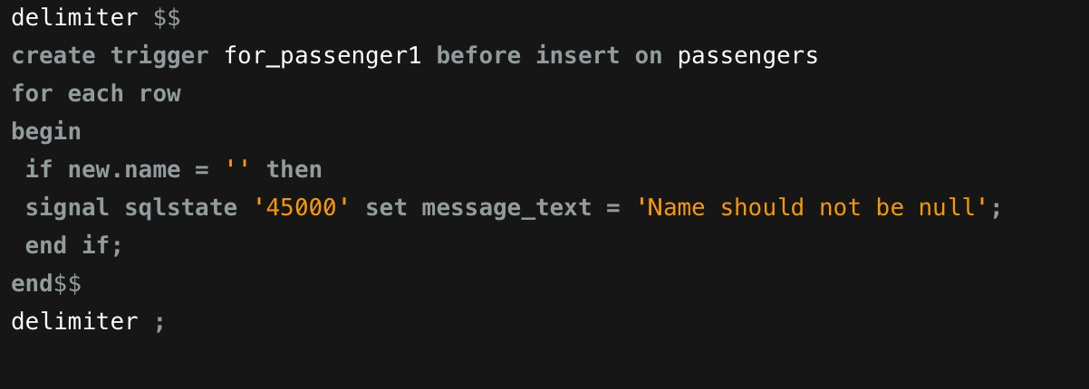

Slide 35
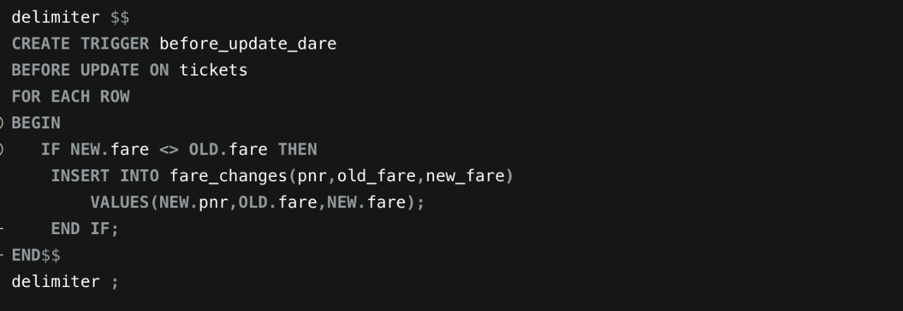
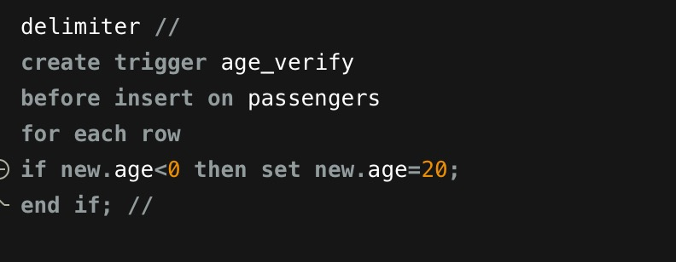

Slide 36
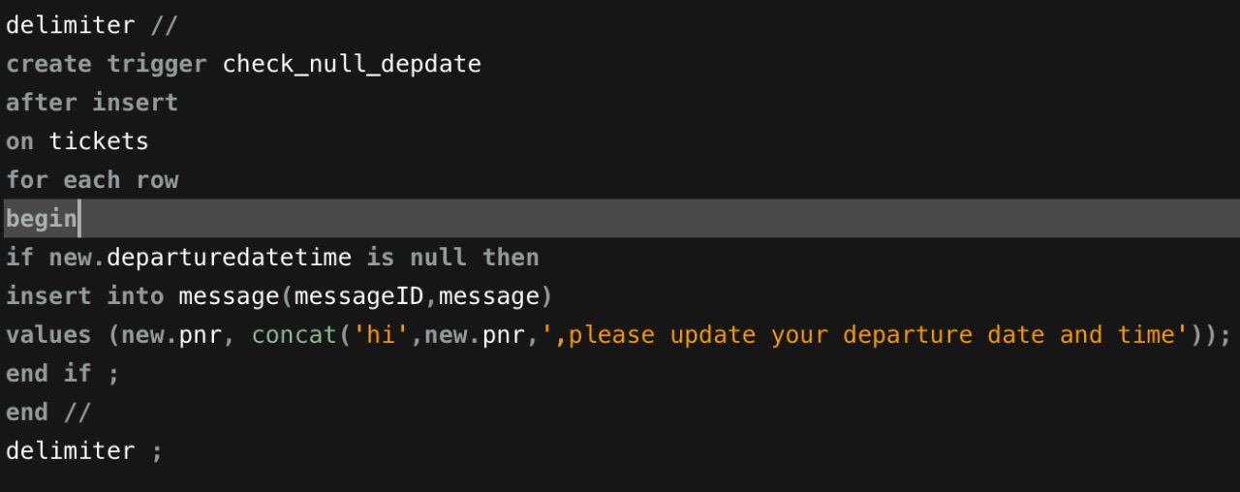

Slide 37
Indexing
An index on an attribute of a relation is a data structure that allows the database system to find those tuples in the relation that have a specified value for that attribute efficiently, without scanning through all the tuples of the relation.

Slide 38
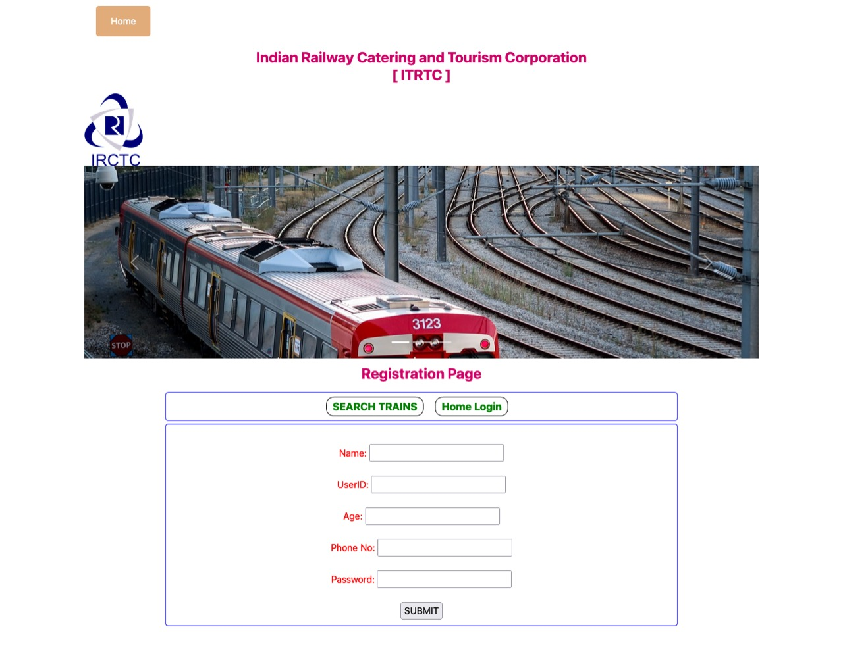
Website UI

Slide 39
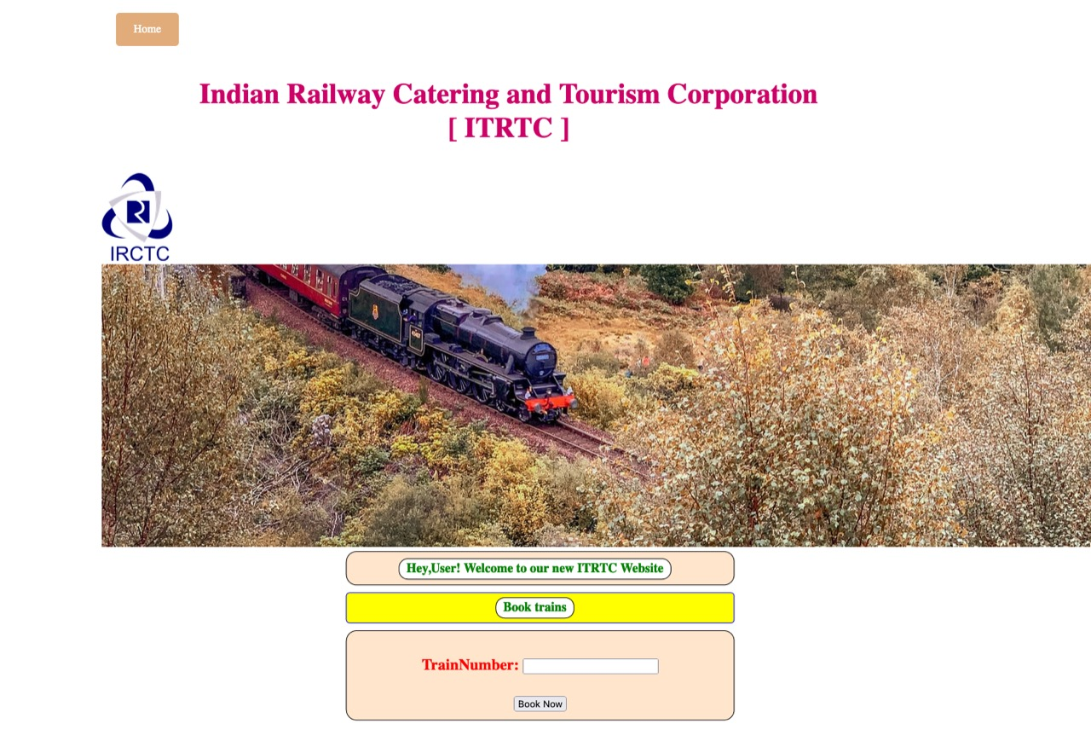

Slide 40
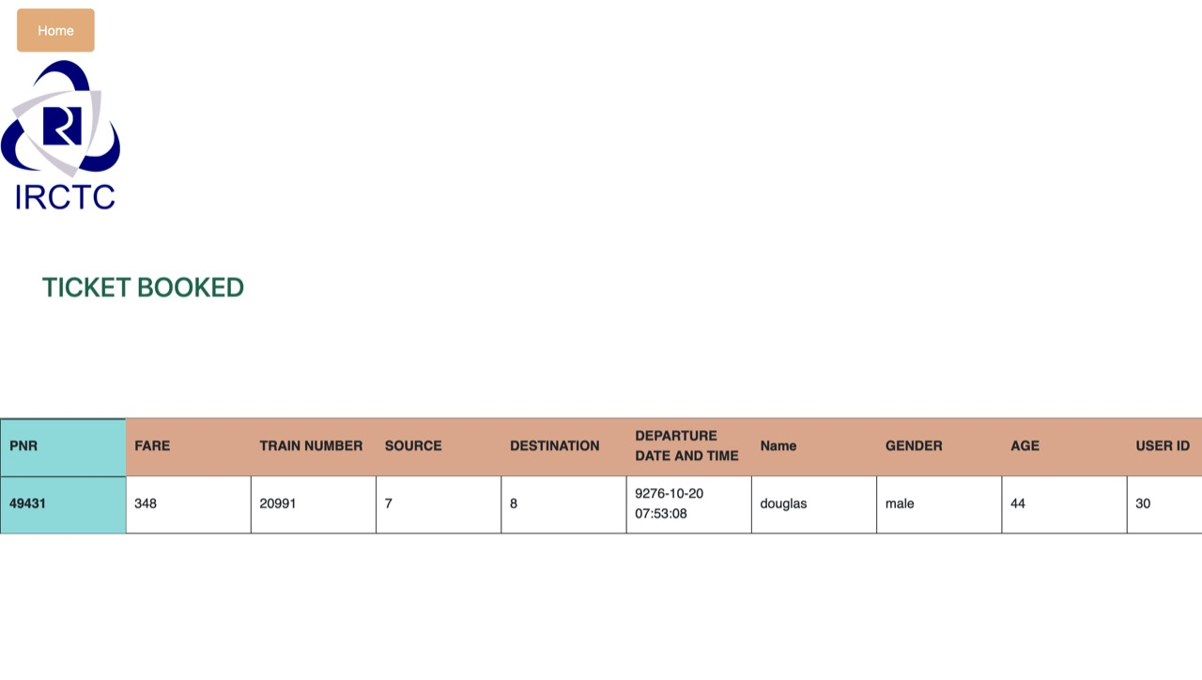

Slide 41
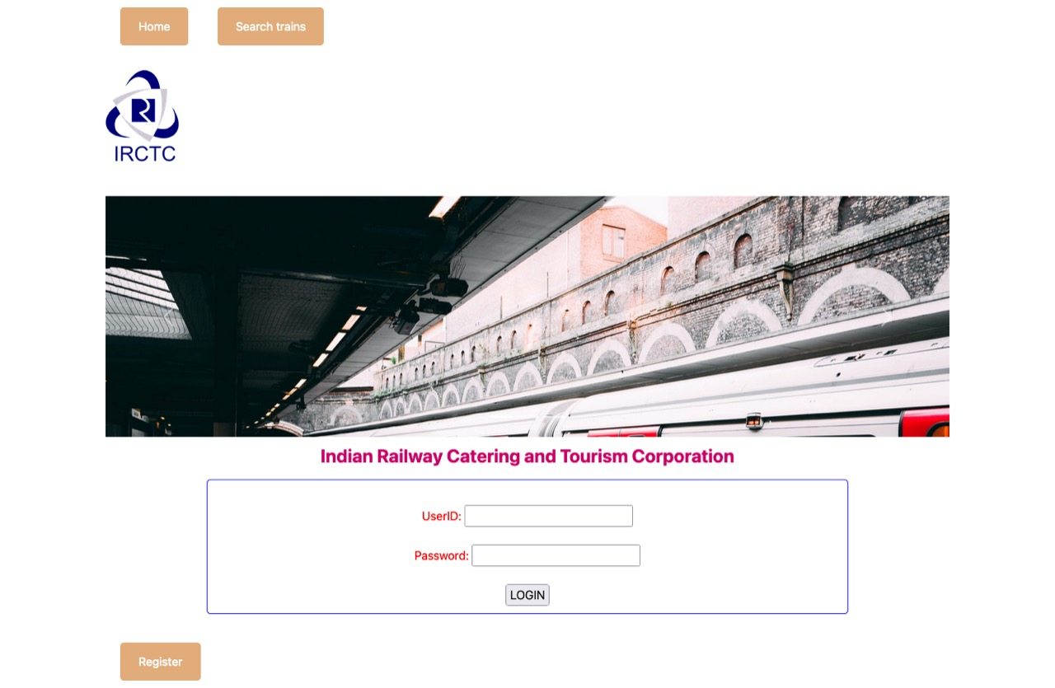

Slide 42
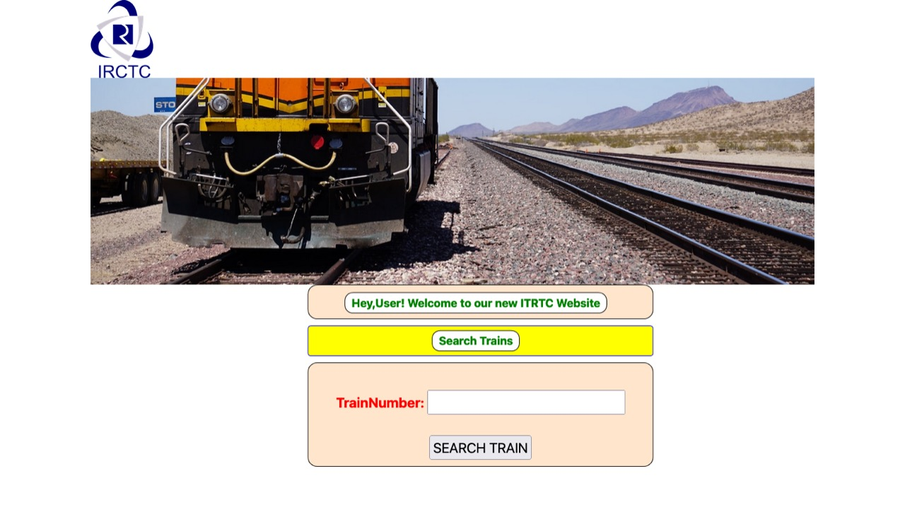

Slide 43
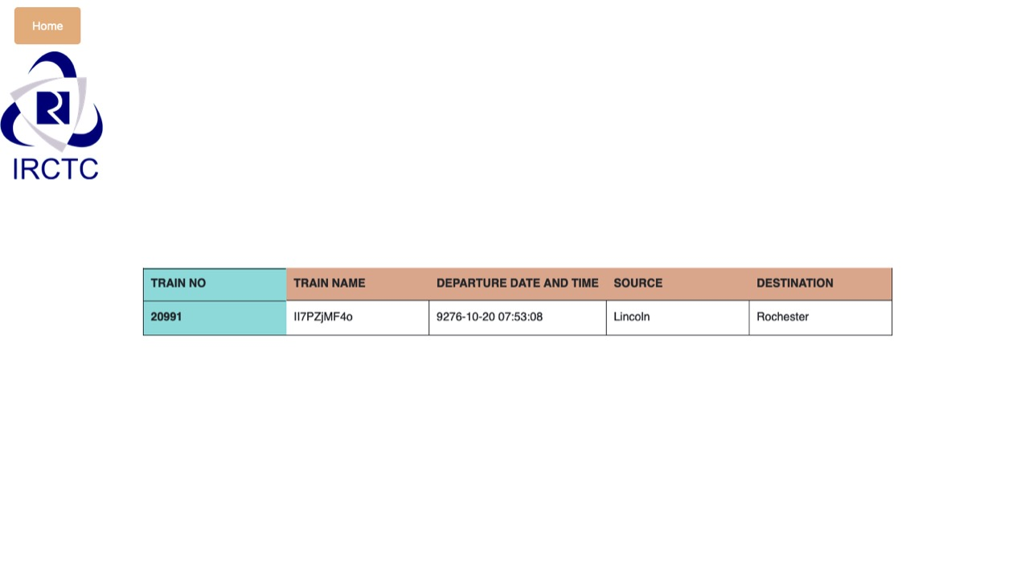

Slide 44
Link to DRIVE (Contains all the code)
https://drive.google.com/drive/folders/1osAiKpk6x4FJX068MKg8hX_Eztaqlndb?usp=sharing

